Slide 1
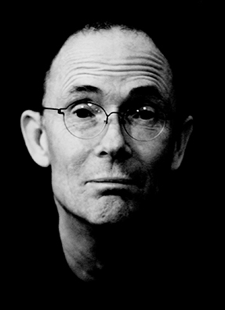
The future is already here — it's just not very evenly distributed.
Photo credit: Frederic Poirot

Slide 2
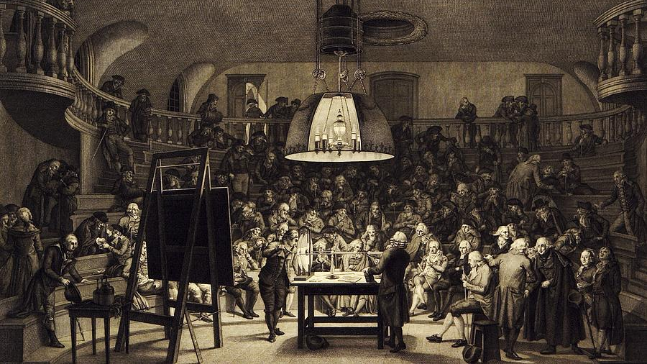
Electricity Demonstration, 18th Century is a photograph by Science Photo Library

Slide 3
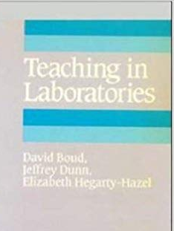
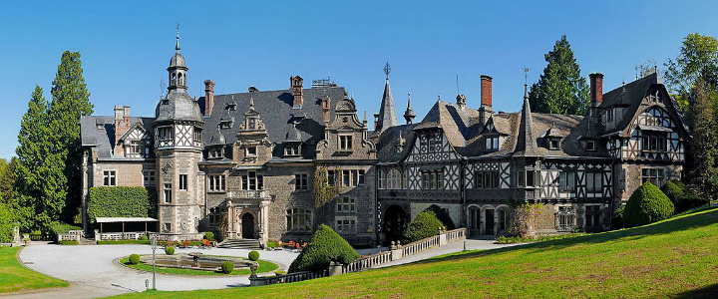
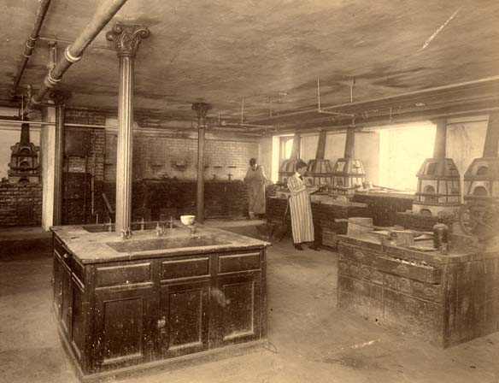
University of Giessen, founded 1607
Liebig introduced labs ca. 190 years ago
Rennselaer Polytechnic Institute, founded 1824
Eaton introduced labs shortly after
https://www.ucalgary.ca/uci/abroad/exchange/giessen
Student feedback does lead to change!
Now nearly 200 years of labs
www.lib.rpi.edu/dept/library/html/Archives/buildings/winslow.html

Slide 4
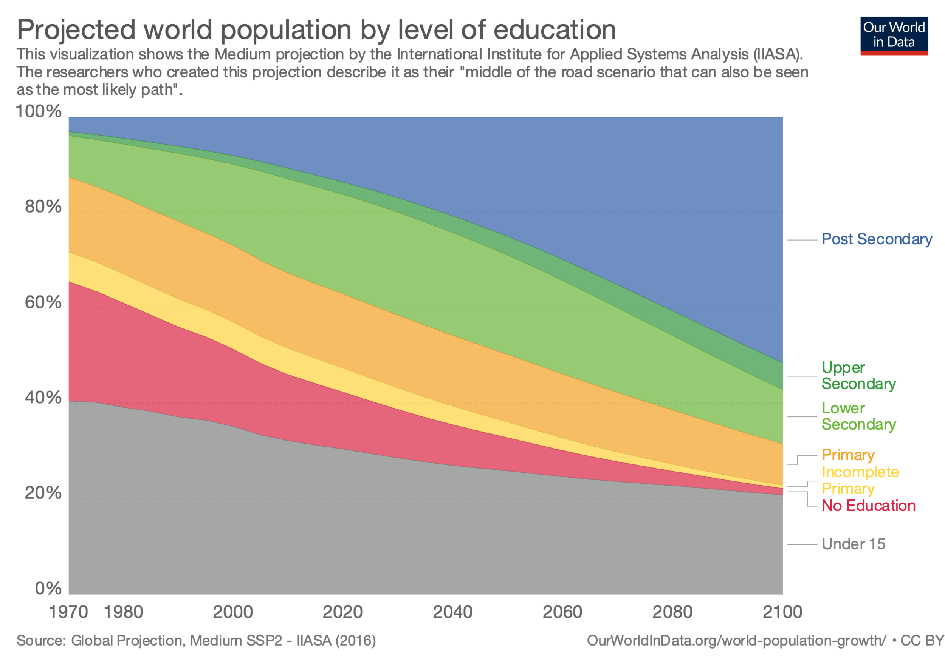

5%
20%
x4
50%
x2.5

Slide 5
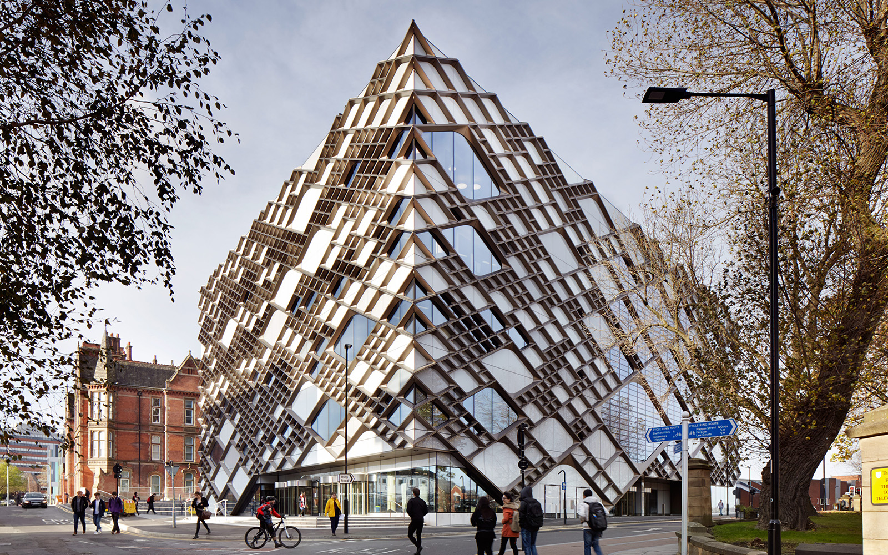
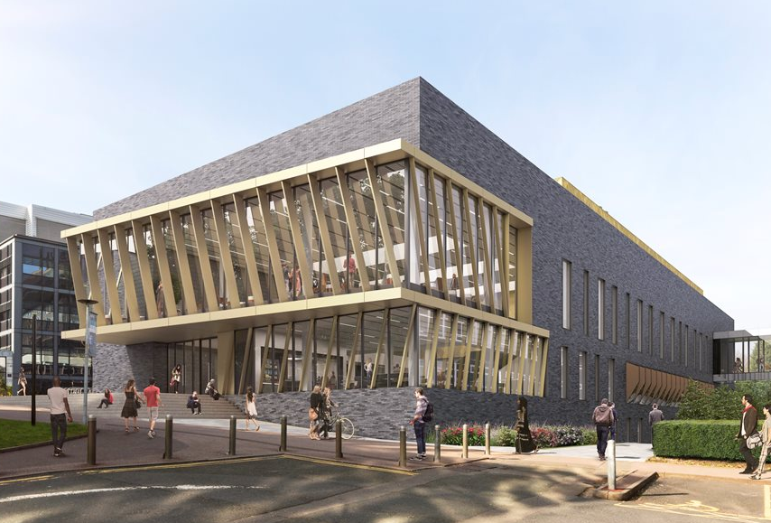
Laboratories now … large scale, dedicated spaces
The Diamond, University of Sheffield, 2015
The CTL, University of Birmingham, 2018
~£90M Capital
19 Labs, 50 Staff
Serves 5000 students
~£40M Capital
3500 UG STEM students

Slide 6
“How do we deal with this expansion [of student numbers]? How do we still engage students early on with the world of engineering? How do we show them the messiness of engineering, the political and social aspects? ... How do we do this beyond the capstone project? This type of education, the type of education we want to have, is expensive. So how do you do this for all students, large cohorts of students, without compromising on everything?”
R. Graham, (2018) “The global state of the art in engineering education,” New Engineering Education Transformation, Massachusetts Institute of Technology, Cambridge, MA, USA

Slide 7
Post—humanistic 'practices of community' for non-traditional laboratory work
T. D. Drysdale, S. Kelley, A.-M. Scott, V. Dishon, J. Scoles The University of Edinburgh Edinburgh, Scotland A. Weightman The University of Manchester Manchester, England
R. J. Lewis Cardiff University Cardiff, Wales
S. Watts The University of Bath Bath, England

Slide 8

Digital alternative for ALL STEM subjects:
Non-traditional practical work
-Remote labs
-Blended labs
-Virtual labs
-Simulations
Pedagogy
Practicality
Sustainability

Slide 9
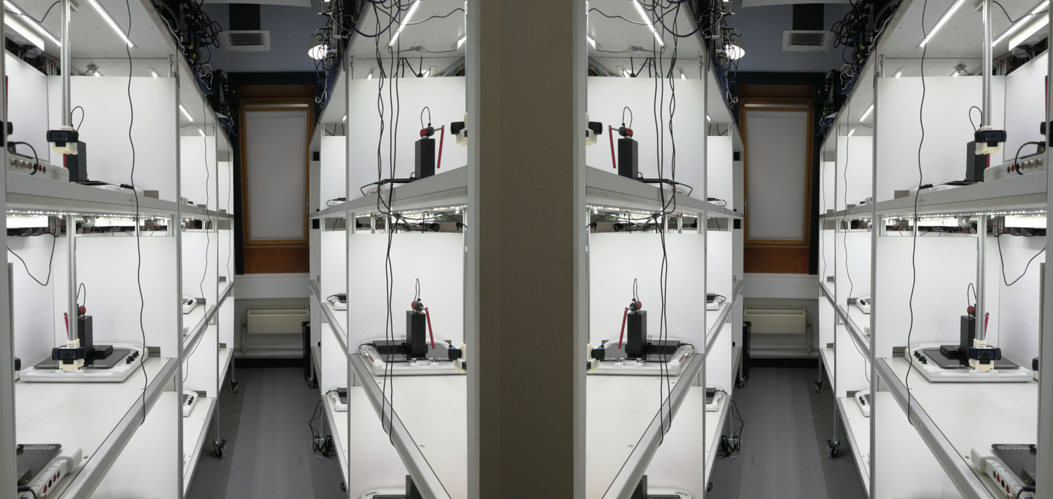
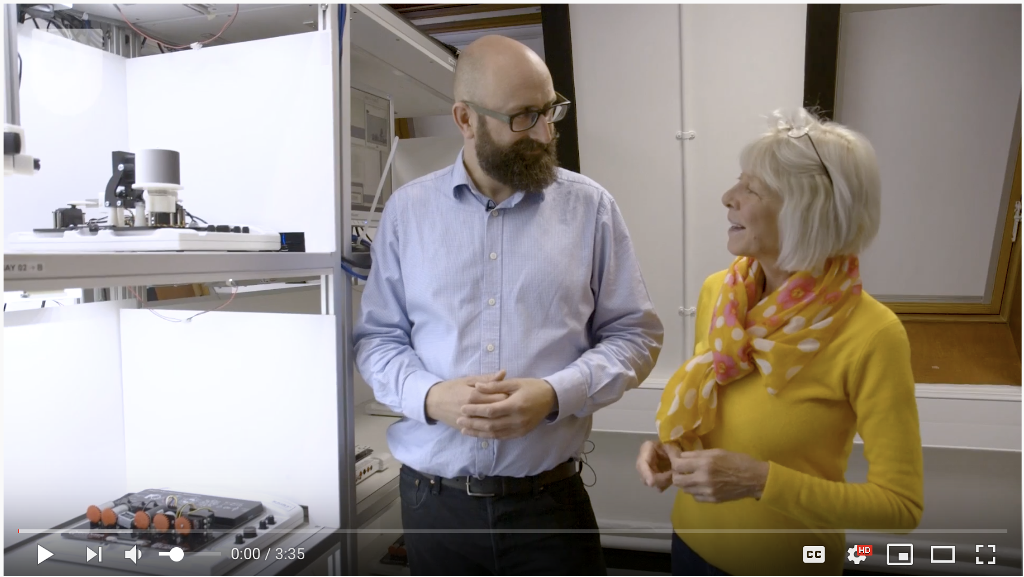
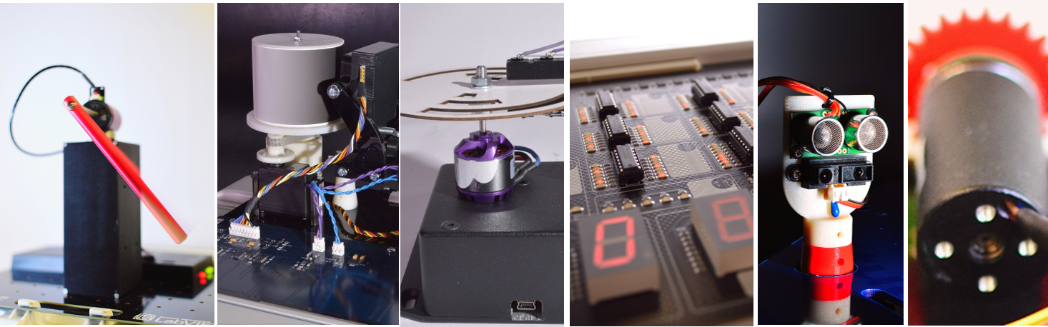
www.youtube.com/watch?v=MSQtI9PPjok
openEngineering Lab, The Open University UK

Slide 10
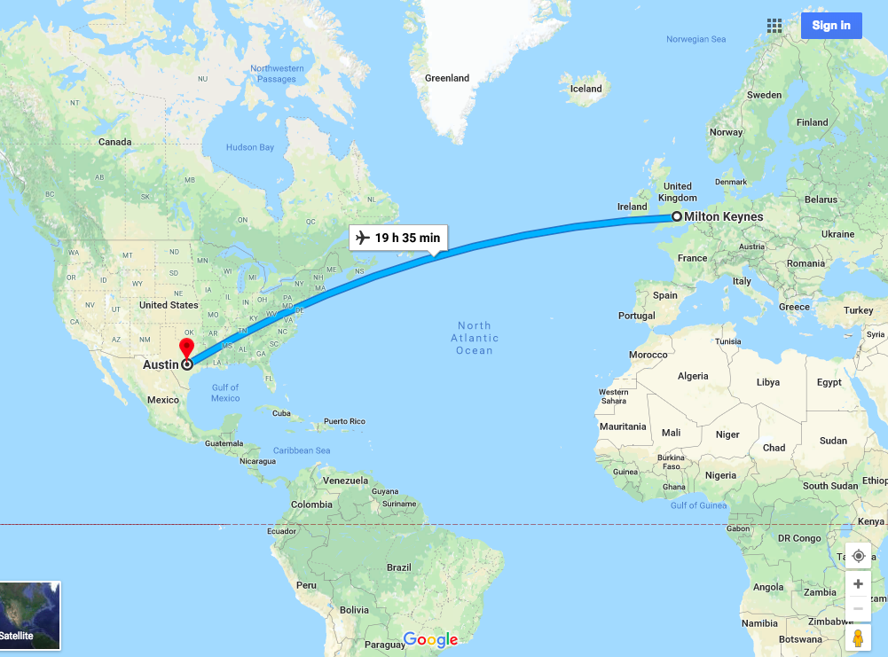
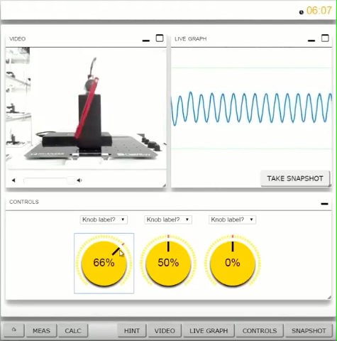

Slide 11
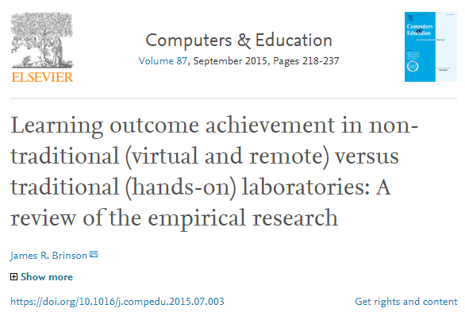
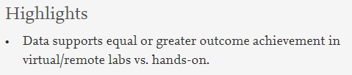
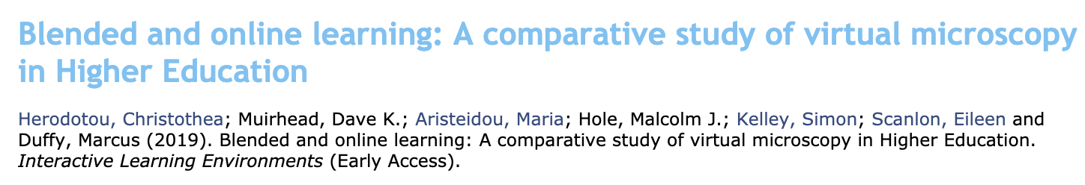
DO TRAD
AND NTPW

Slide 12
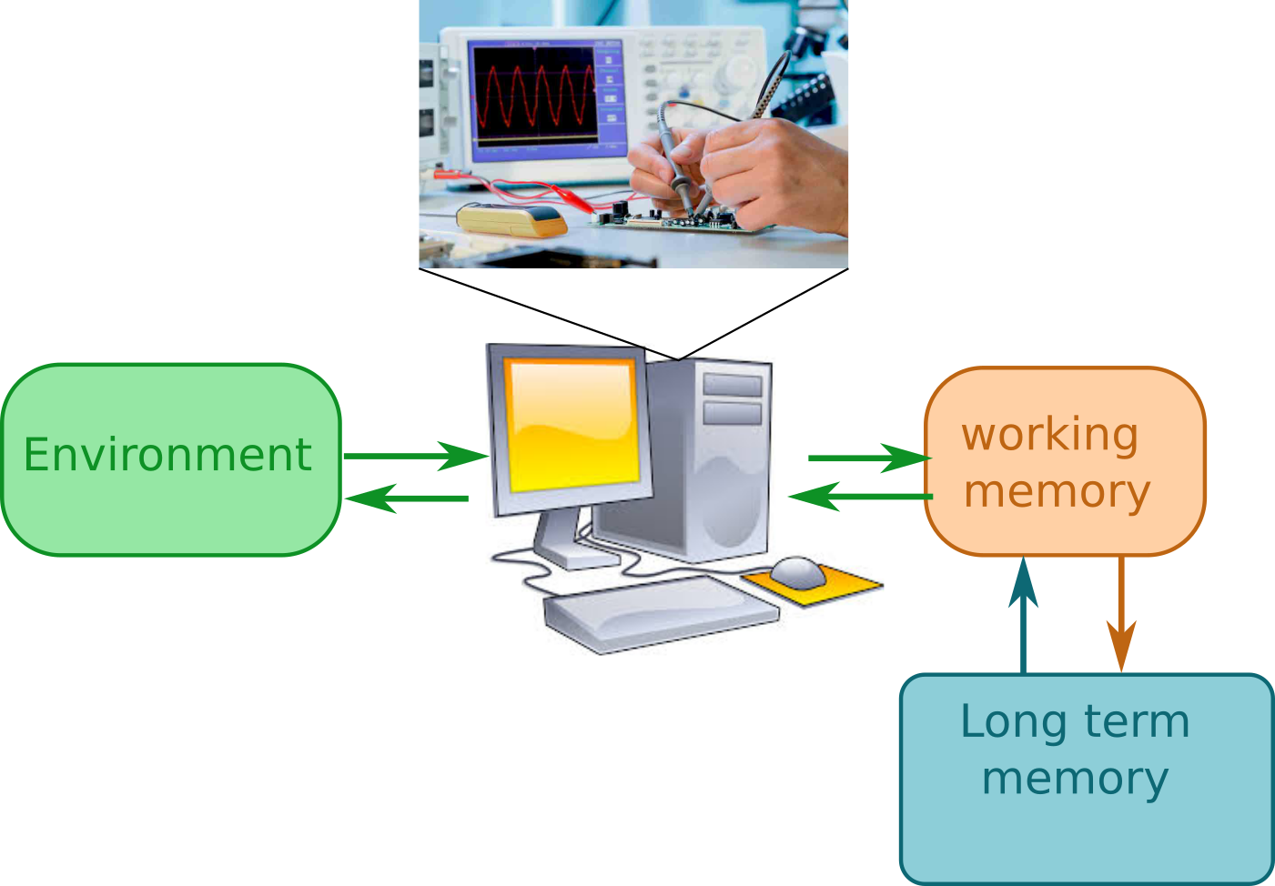
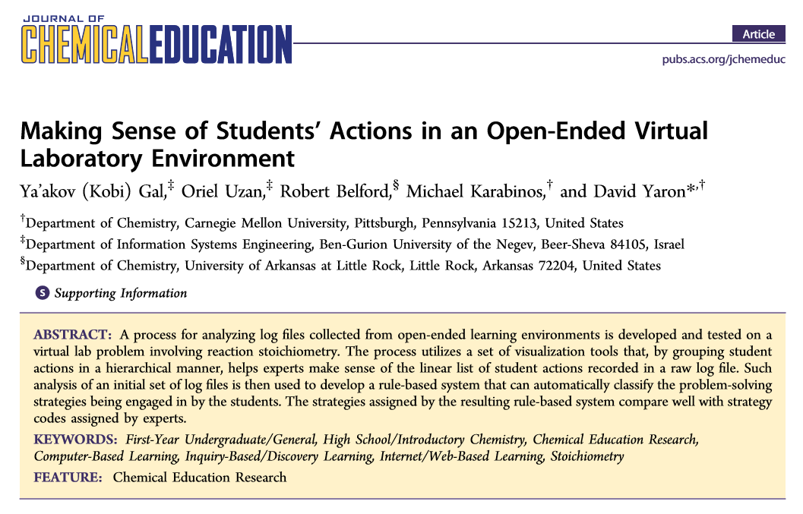
Automated evaluation
Authentic assessment
AI for observability 24/7
EJ framework tolerates AI limitations
Break toxic cycle of feedback dependency

Slide 13
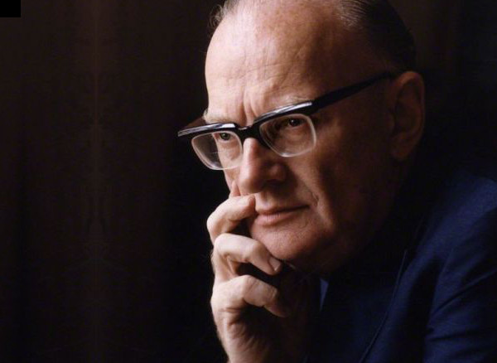
Any teacher who can be replaced by a machine, . . . should be.
Photo credit: celestis.com

Slide 14
Quality/Benefit
Human
Technology
Pedagogical approaches

Slide 15
Understanding student and staff practice
Practice is widely cited as being integral to issues of knowing and learning at work, via the notion of ‘communities of practice’ (CoP) Lave & Wenger (1991).
Legitimate peripheral participation –knowledge as socially constructed, where newcomers learn social and cultural practices through apprentice-style learning from older colleagues.
What about newcomers working in industry or with a problem which is so new, there is no CoP? How can engineers learn from others if the practices and knowledge are yet to be developed, or are changing so rapidly they fail to stabilise?

Slide 16
Should we be teaching ‘best’ practice?
Sociotech environments can be difficult to predict - challenges the idea that ‘best practice’ is a ‘thing’ that should be solidified, static, or final.
Term ‘community of practice’ transposed as ‘practices of community’ (Gherardi, 2009)
Emphasise practices (plural) are multiple, non-finalised performances that evolve over time.
Immediately questions notion of a having a fixed behaviour that we are trying to teach a student within a given activity.
Multiple ways of practicing must be reflected in the implementation, evaluation and support given to both staff and students.

Slide 17
What does this learning look like in NTPW?
Hardware and software designs naturally set a scope for the exploration that students can undertake.
However, students to need to think about surprising and unexpected results, and explore different sets or variations of parameters without rushed to complete or having to worry about being negatively judged.
This promotes learning values associated with malleable intelligence: exploring and practicing.
Not by a step-by-step procedural lab sheet, but prompted by the actions of the teacher-like functions.
Students receive both intended and unintended messages in traditional work, and the same holds true for NTPW.

Slide 18
Humans and technology working together
There is already the potential for a significant amount of hinting and guidance that can be embedded in the user interface.
Bayne’s chatbot used to interact with students on a digital humanities course.
NTPW activities are potential collaborative partners that could bring their own agency to bear in assisting student learning by fulfilling some teacher-like functions, such as hinting, guiding or even challenging students.

Slide 19
Open-ended practice
As the students move to more senior years, user interfaces should become more open-ended. For project work, activities might be programmed directly by the student and/or the data analysed in Jupyter notebooks
NTPW activities
Staff
Students
Educational Collaboration
in practices of community

Slide 20
A new way of thinking: Post humanism
Non-human agents, such as technological artefacts, are of equal status to human participants
Emphasise that technology should be valued on its own terms, rather than on how well it can replace humans: complement; not compete.
As Edwards points out, the ‘post’ in post-human is not anti-humanistic: “it is not ‘after’ in terms of going beyond, but in terms of offering a constant experimentation with or questioning of the human”.

Slide 21
NTPW supporting practices of community
What then can be done in higher education to provide experience of this?
Subject knowledge has long-term relevance, and staff are authorities, so it cannot be done in the existing curriculum.
NTPW activities offer a rapid refresh and update cycle (unlike conventional laboratories), where students engage with leading edge technological concepts.
Posthuman gaze: Observe and support the behaviour of relations between the technologies, senior students, tutors, and staff when handling newer technologies/concepts before the concepts and practices around those technologies have stabilised.

Slide 22
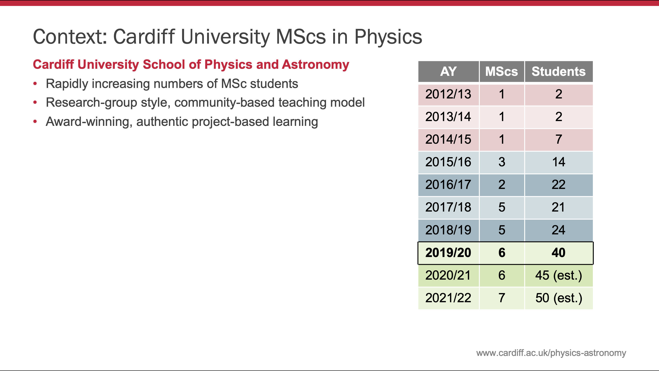

Slide 23
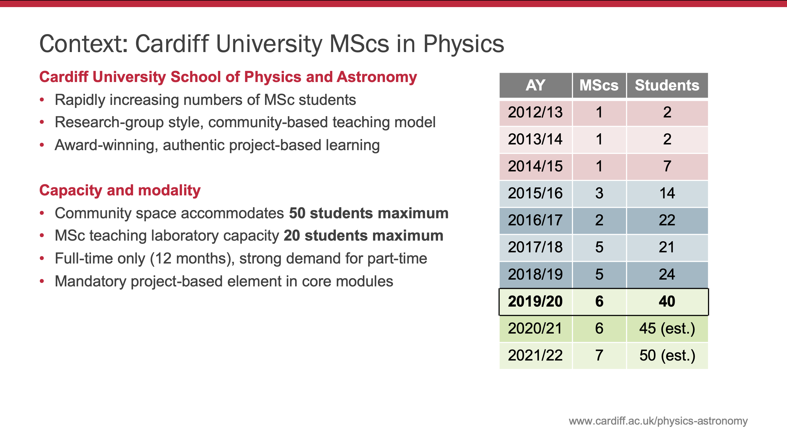

Slide 24
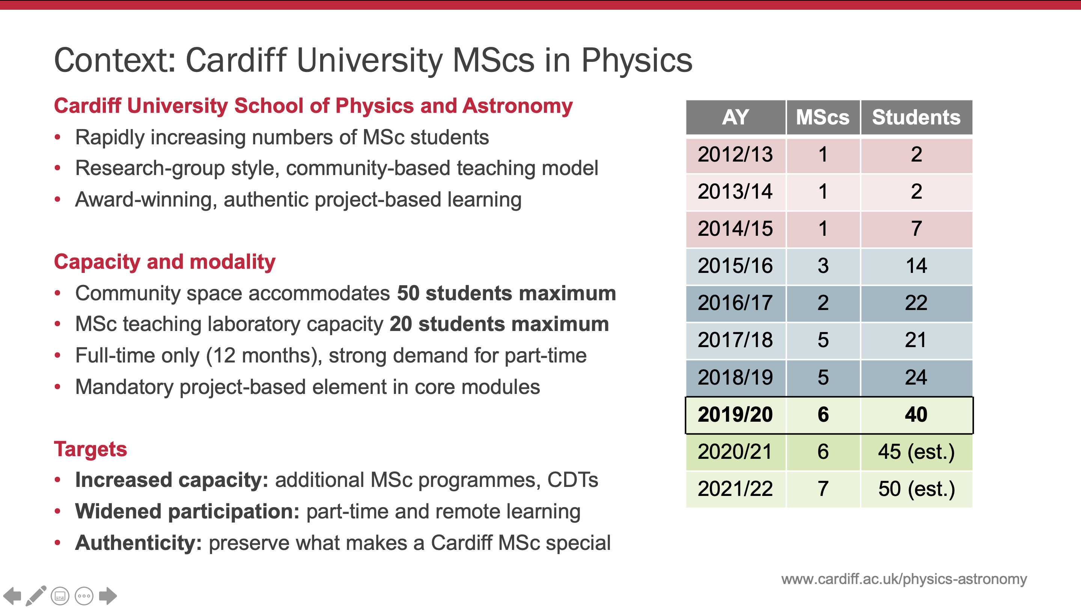

Slide 25
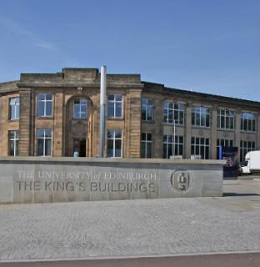
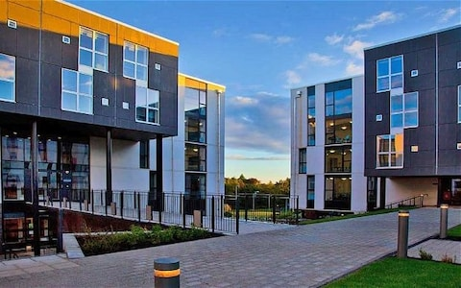
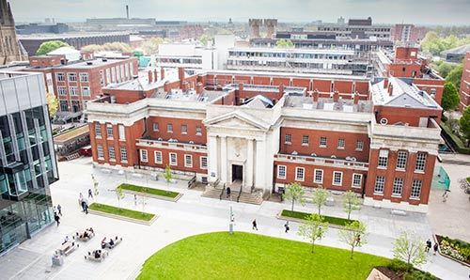
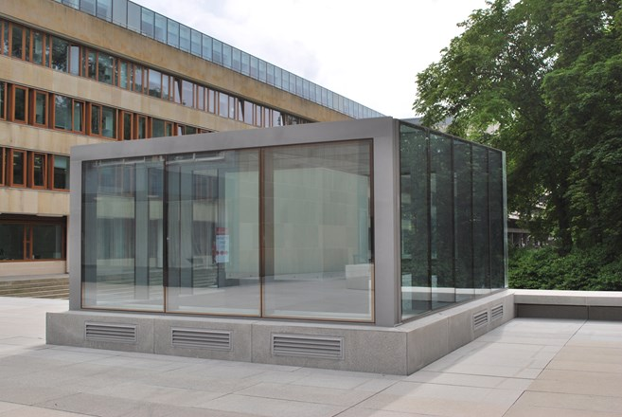
Share kit across locations to break down teaching silos
e.g. art and engineering
Allocator
Pooling between institutions for
diversity, throughput, and resilience

Slide 26
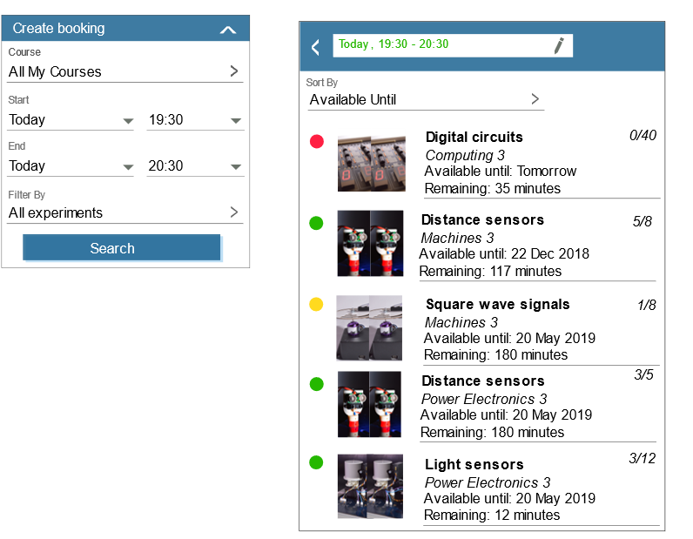


Slide 27
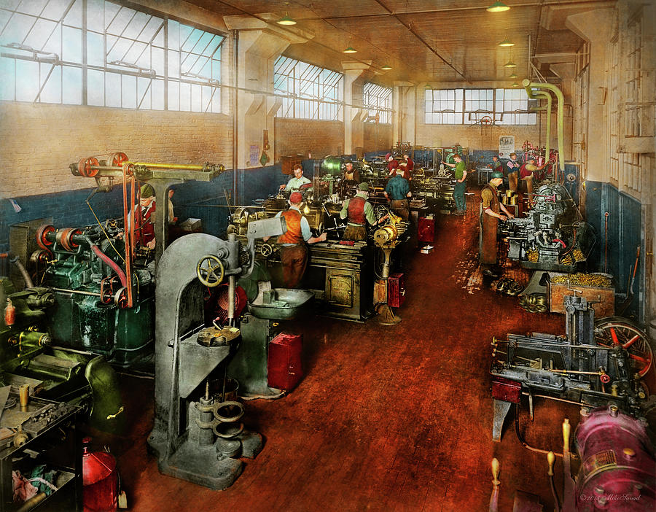

Workshop technicians +
Learning Technology Developers

Slide 28
